Slide 1
Bringing Talent Together

Slide 2
Mobile Technology
Keeping up in a fast paced world…

Slide 3
Mobile Technology
Keeping up in a fast paced world…

Slide 4
Mobile Technology
Catching
Keeping up in a fast paced world…

Slide 5
We’ve heard our libraries should be more like…

Slide 6
We’ve heard our libraries should be more like…
Big Business – Where our patrons are “customers”

Slide 7
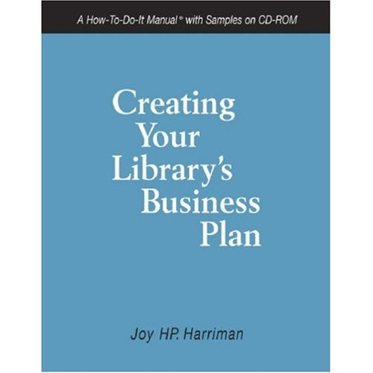
We’ve heard our libraries should be more like…
Big Business – Where our patrons are “customers”

Slide 8
Definition of Patron:

Slide 9
Definition of Patron:
a person who is a customer, client, or paying guest, especially a regular one, of a store, hotel, or the like.

Slide 10
What if we viewed the library as a Hotel?

Slide 11
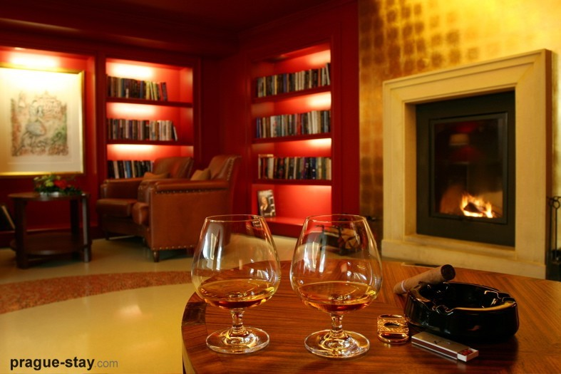
What if we viewed the library as a Hotel?

Slide 12
… and our patrons as Guests…

Slide 13
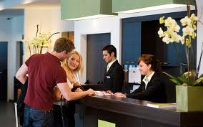
… and our patrons as Guests…

Slide 14
They already sleep here…

Slide 15
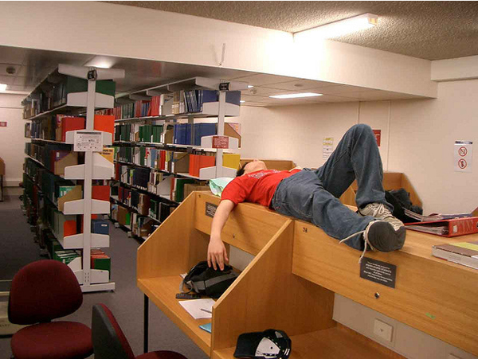
They already sleep here…

Slide 16
They already eat here…

Slide 17
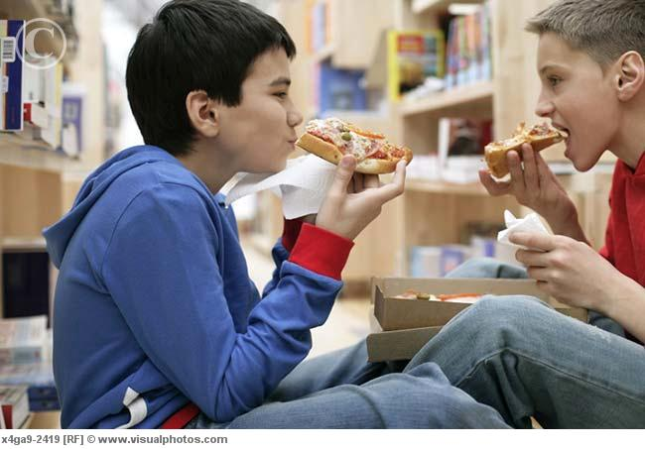
They already eat here…

Slide 18
…and they leave the place a mess…

Slide 19
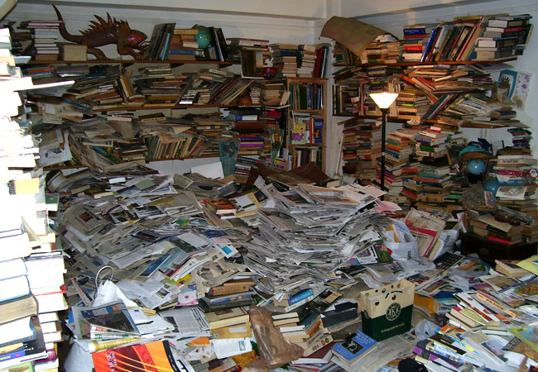
…and they leave the place a mess…

Slide 20
In One Word…

Slide 21
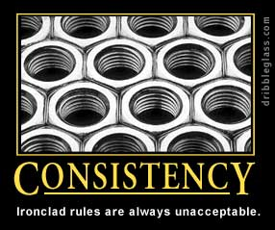
In One Word…

Slide 22
In One Word…
Every Patron “EXPERIENCE” should be the same…

Slide 23
“The Patron Experience”

Slide 24
Focus…
Let’s Go Deeper…

Slide 25
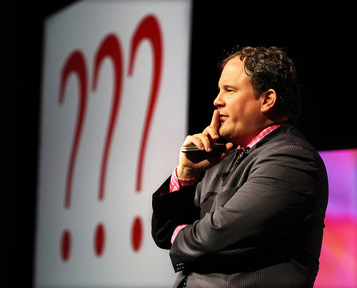

Slide 26
Eppo van Nispen

Slide 27
Eppo van Nispen - Inspirational Speaker and Library Advocate

Slide 28
Eppo van Nispen - Inspirational Speaker and Library Advocate - 2010 ALA Keynote Speaker
Washington, D.C.

Slide 29
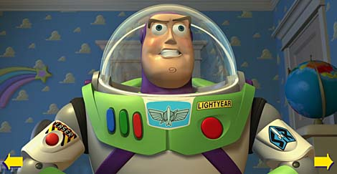
Eppo van Nispen - Inspirational Speaker and Library Advocate - 2010 ALA Keynote Speaker
Washington, D.C.
- Tag-Line… “To Infinity & Beyond”

Slide 30
Eppo van Nispen - Inspirational Speaker and Library Advocate - 2010 ALA Keynote Speaker
Washington, D.C.
- Tag-Line… “To Infinity & Beyond”
Started the highly acclaimed Library Concept Center in the Netherlands

Slide 31
Eppo van Nispen - Inspirational Speaker and Library Advocate - 2010 ALA Keynote Speaker
Washington, D.C.
- Tag-Line… “To Infinity & Beyond”
Started the highly acclaimed Library Concept Center in the Netherlands
In 2008 the Library Concept Center was designated by international experts as the worldwide number one library in innovation

Slide 32
Eppo van Nispen - Inspirational Speaker and Library Advocate - 2010 ALA Keynote Speaker
Washington, D.C.
- Tag-Line… “To Infinity & Beyond”
Started the highly acclaimed Library Concept Center in the Netherlands
In 2008 the Library Concept Center was designated by international experts as the worldwide number one library in innovation
In 2009 they were appointed as the best library of the Netherlands

Slide 33
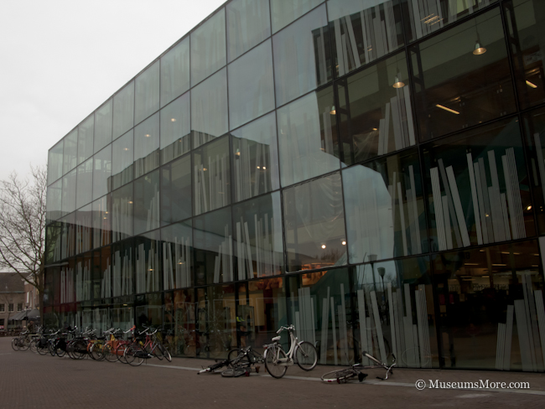
DOK Library Concept Center – Delft, (The Netherlands).

Slide 34
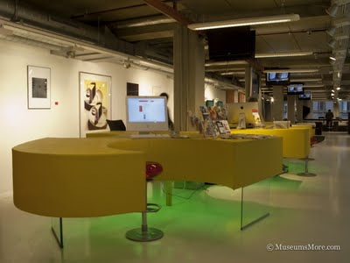
DOK Library Concept Center – Delft, (The Netherlands).

Slide 35
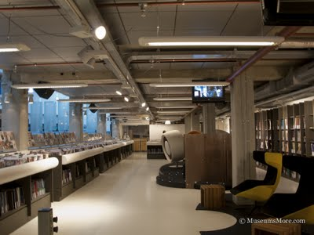
DOK Library Concept Center – Delft, (The Netherlands).

Slide 36
Eppo van Nispen - Inspirational Speaker and Library Advocate - 2010 ALA Keynote Speaker
Washington, D.C.
Eppo van Nispen - Inspirational Speaker and Library Advocate - 2010 ALA Keynote Speaker
Washington, D.C.
- Tag-Line… “To Infinity & Beyond”

Slide 37
Eppo van Nispen - Inspirational Speaker and Library Advocate - 2010 ALA Keynote Speaker
Washington, D.C.
Eppo van Nispen - Inspirational Speaker and Library Advocate - 2010 ALA Keynote Speaker
Washington, D.C.
- Tag-Line… “To Infinity & Beyond”
They wanted a real mission, not a gray one. He wanted to go to “Infinity & Beyond”, to become "a better friend than Google“

Slide 38
Eppo van Nispen - Inspirational Speaker and Library Advocate - 2010 ALA Keynote Speaker
Washington, D.C.
Eppo van Nispen - Inspirational Speaker and Library Advocate - 2010 ALA Keynote Speaker
Washington, D.C.
- Tag-Line… “To Infinity & Beyond”
They wanted a real mission, not a gray one. He wanted to go to “Infinity & Beyond”, to become "a better friend than Google“
“All we need, is more courage to do what must be done - to make deep changes in the culture of library that will allow us to connect with our library’s users. That connection is the only way libraries will continue to exist in the post-Google world”.

Slide 39
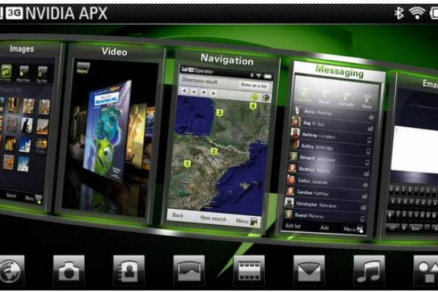
Mobile Services – Technology effects every area of service in our library.

Slide 40
Mobile Services – Technology effects every area of service in our library. What mobile services do we provide?

Slide 41
Mobile Services – Technology effects every area of service in our library. What mobile services do we provide? How do the patrons use them?

Slide 42
Mobile Services – Technology effects every area of service in our library. What mobile services do we provide? How do the patrons use them?
Are they being used to the potential of the service?

Slide 43
Quick Question…?

Slide 44
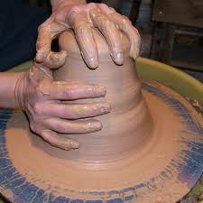
Quick Question…?
Are we modeling our services to our patrons?

Slide 45
Quick Question…?
Are we modeling our services to our patrons?
Or...

Slide 46
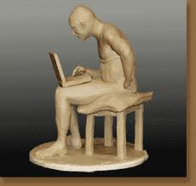
Quick Question…?
Are we modeling our services to our patrons?
Or...
Our patrons to our services?

Slide 47
We Need…

Slide 48
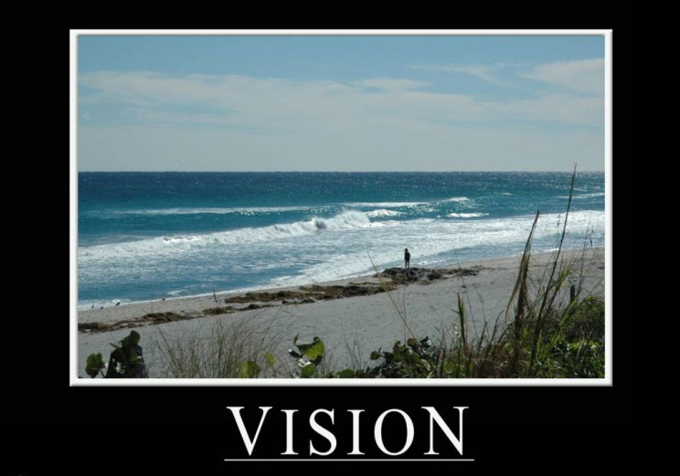
We Need…

Slide 49
We Need…
For Our Libraries…

Slide 50
We Need…
For Our Libraries… What Could Our Libraries Become???

Slide 51
You can make the difference that your library needs to “catch up”

Slide 52
You can make the difference that your library needs to “catch up”
You are “investing” in your patrons

Slide 53
You can make the difference that your library needs to “catch up”
You are “investing” in your patrons
The Patrons have already “invested” in us They are depending on us…

Slide 54
Bob Johnson bob@portjefflibrary.org

