Slide 1
Don’t Fear the eBook Stephen Ingram

Slide 2
According to the research, 19 percent of U.S. adults own eReaders and 19 percent of U.S. adults own tablets. While both markets were practically nonexistent in 2009, they have become a booming marketplace for publishers.”

Slide 3
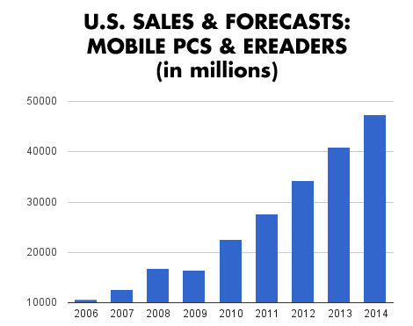
The State of the Tablet and Ereader Market

Slide 4
Maybe we should be afraid of eBooks?

Slide 5
EBooks will kill the library?

Slide 6
Amazon has a monopoly on eBooks!

Slide 7
We are trapped behind a wall!

Slide 8
But there is hope!

Slide 9
What do we have to know to climb the wall?
DRM
Time
Hardware
Software

Slide 10
Digital Right Management
Publishers have created artificial barriers between devices
Artificial restrictions with use.
Pricing models are undergoing change.

Slide 11
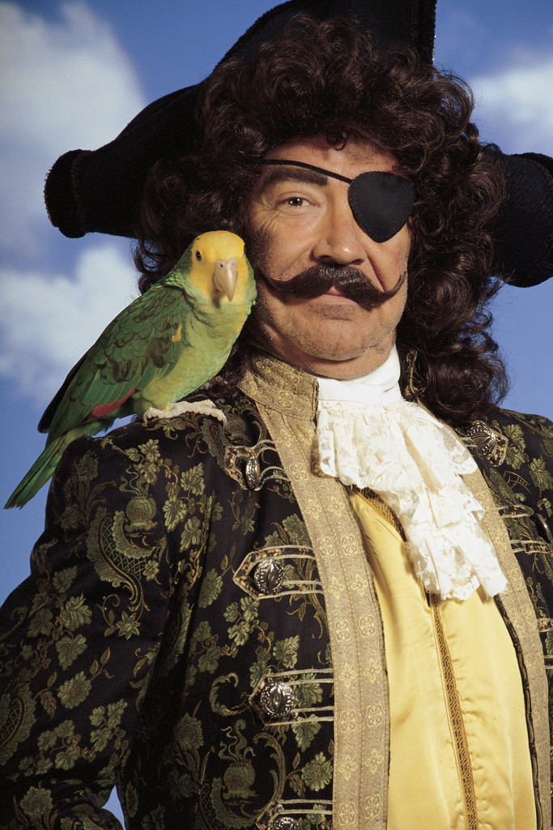

Slide 12
Time
How much time does the patron have?
How much time do you have to help?
Do you have a procedure/coverage?
Are you learning this technology?

Slide 14
Hardware
Which device do you have?
Is it tethered or free standing?
Do you have wireless?
iPad vs. Android vs. Nook vs. Kindle

Slide 16
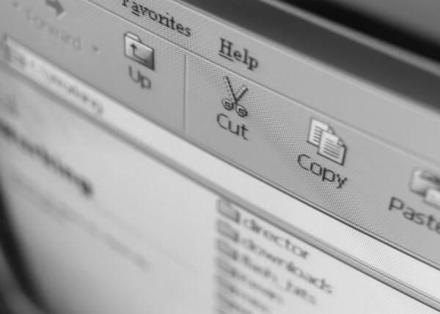
Software
Software interface.
Password and account information.
Amazon vs. Adobe.

Slide 18
How do we overcome these barriers?
Instructions
Mentoring
Education
Experience

Slide 19
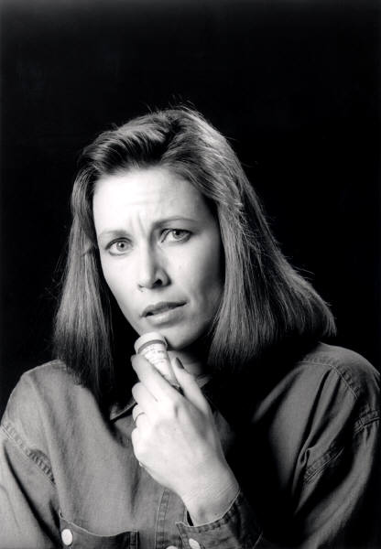
Instructions
What information do you hand the patron?
One-on-One instructions?
Tech coral?
Classes?

Slide 20
Mentoring
Who is your library eBook guru?
Are they sharing?
Are you asking?

Slide 21
Education
Blogs
Articles
Interest

Slide 22
Experience
Buy a device.
Have you library buy several.
Offer them to the patrons as loans.

Slide 23
Patrons and staff must have basic literacy in the following skills:
Computer use
Web navigation
Checkout procedure
Navigating their specific device.

Slide 24
The Future
Will libraries create their own eBooks?
Publishers are currently suing distributors.
Will DRM disappear?
What new technologies will we have to buy/understand.
ILS vendors must work with digital books.

Slide 25
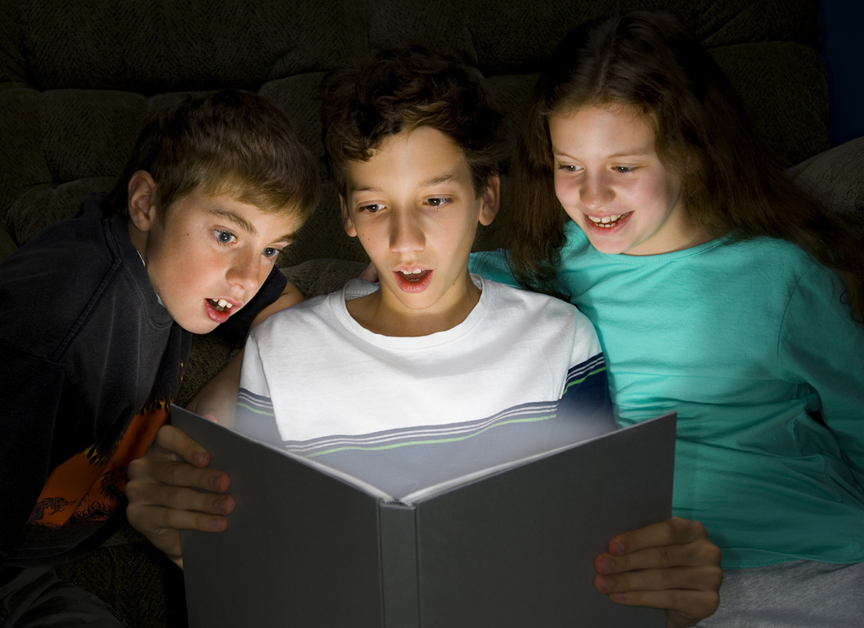
Our goal is to make patrons and staff self-sufficient reader of ebooks.

Slide 26
The Library’s goal is to promote literacy in any form.

Slide 30
Don’t Fear

Slide 31
That which does not kill us, usually kills the next in line.
Any questions???

Slide 32
notes
http://stephenslighthouse.com/
http://pewresearch.org/
http://agnosticmaybe.wordpress.com/
http://libraryrenewal.org/
http://lifehacker.com/
http://www.thedominoproject.com/

