Slide 1
Don’t fear the ebook!
Training staff and patrons
Ellen Druda Half Hollow Hills Community Library
edruda@suffolk.lib.ny.us

Slide 2
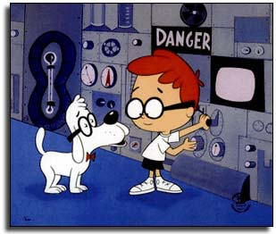
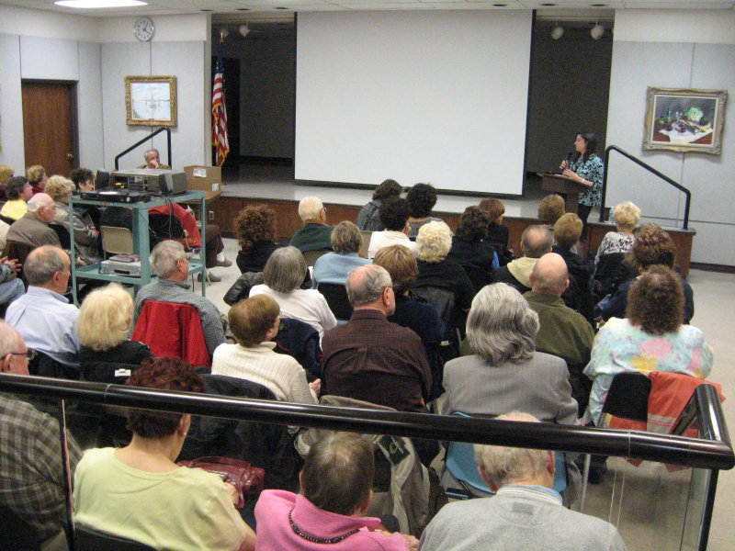
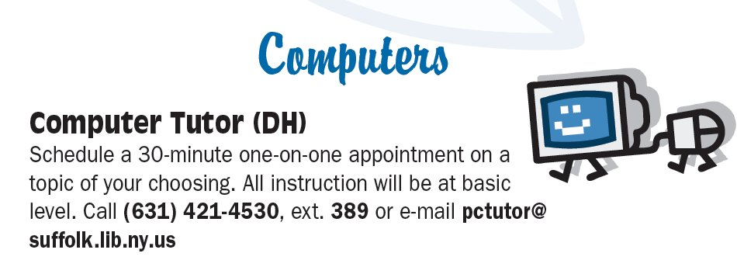
Wayback Machine
computer users groups
classes
Computer Tutor

Slide 3
TechnoLab

Slide 5
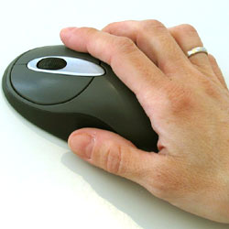
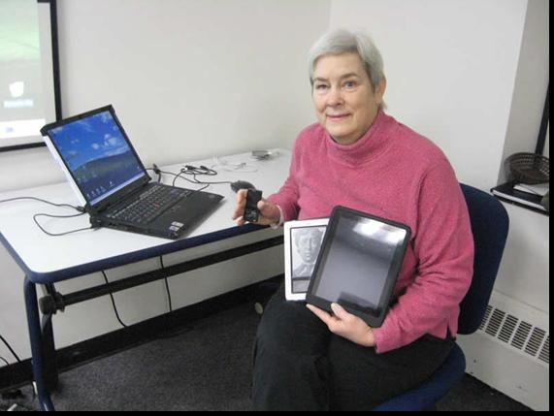
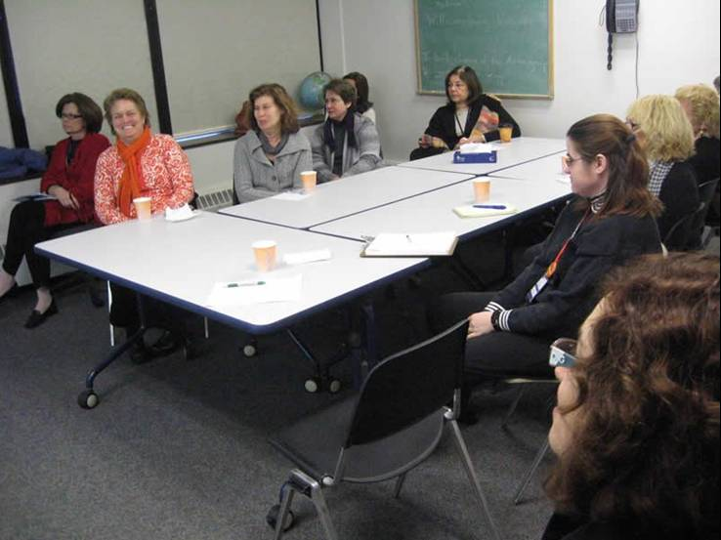
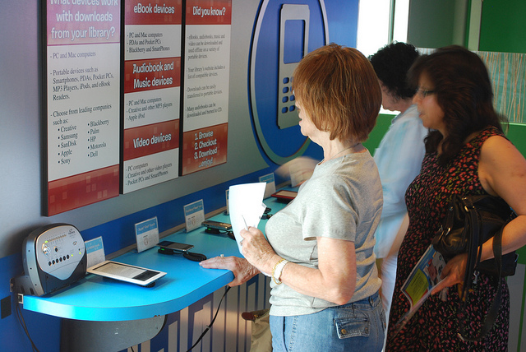
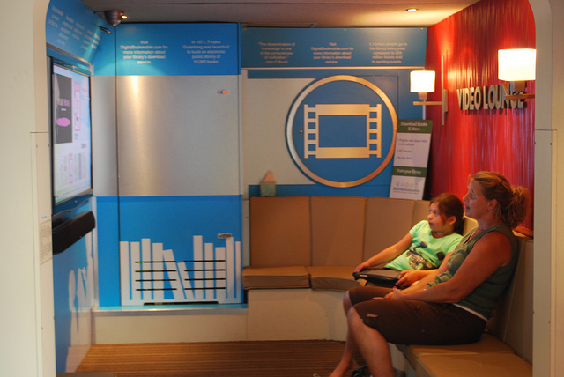
Hands On

Slide 6
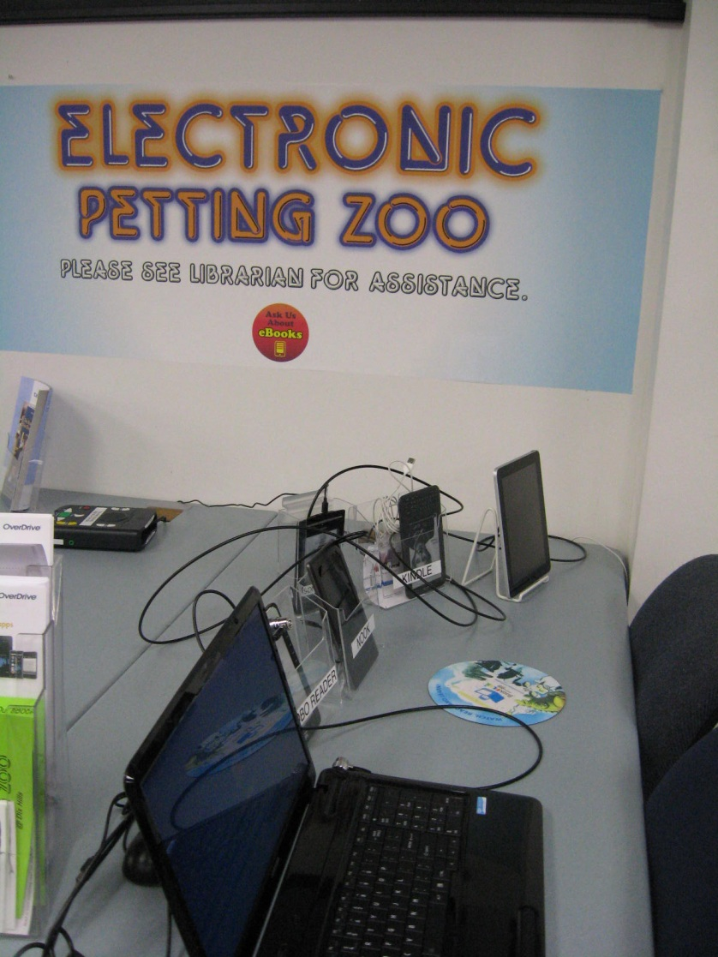
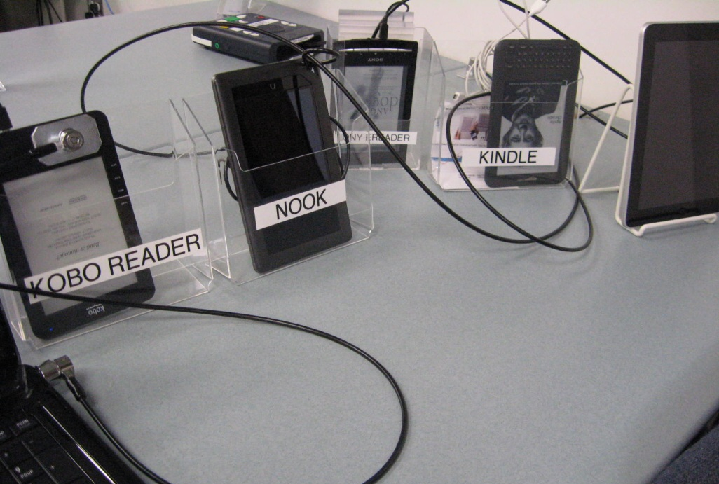

Slide 7
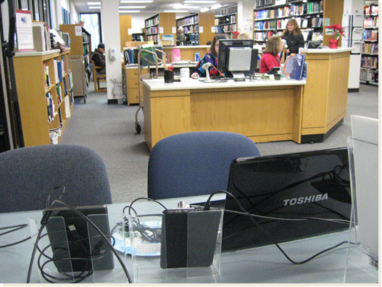
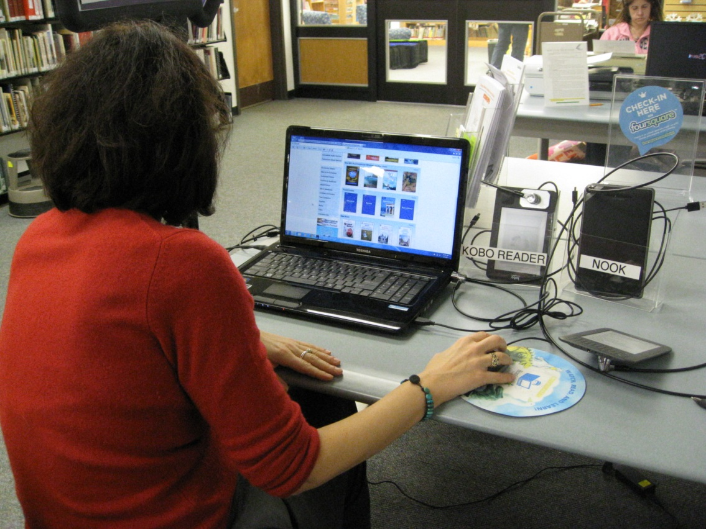
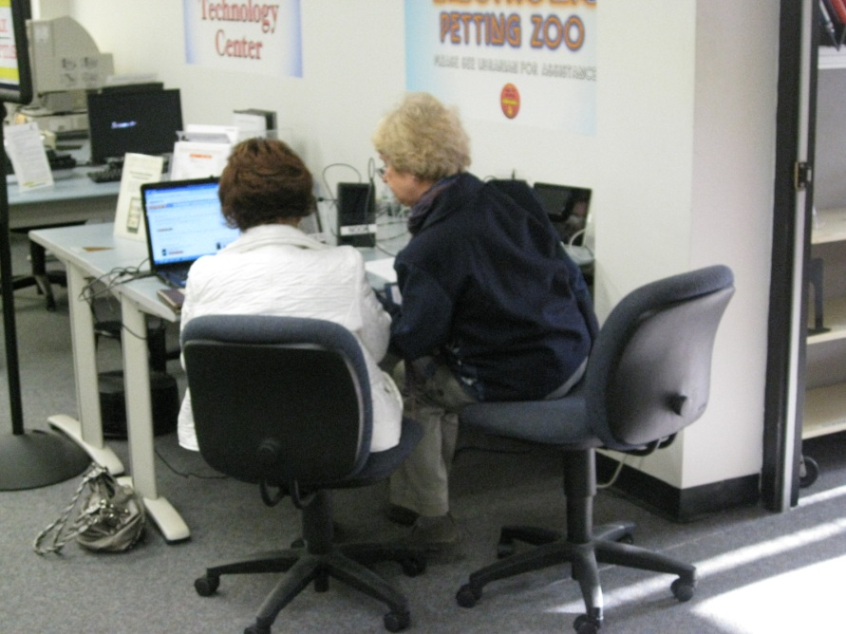
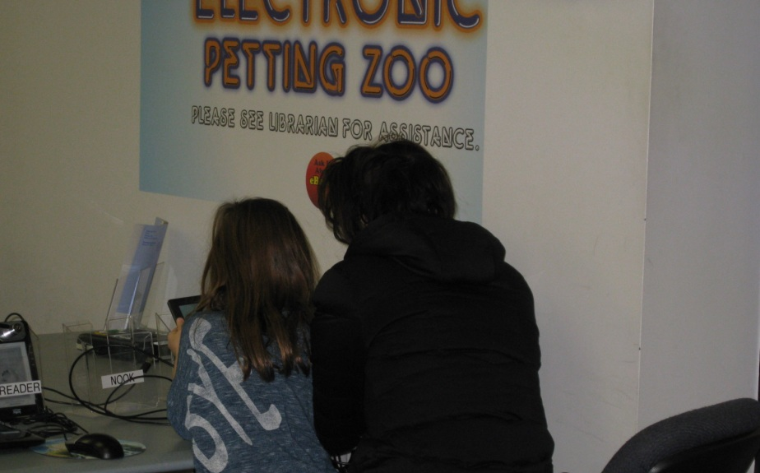
Zoo in Action

Slide 8
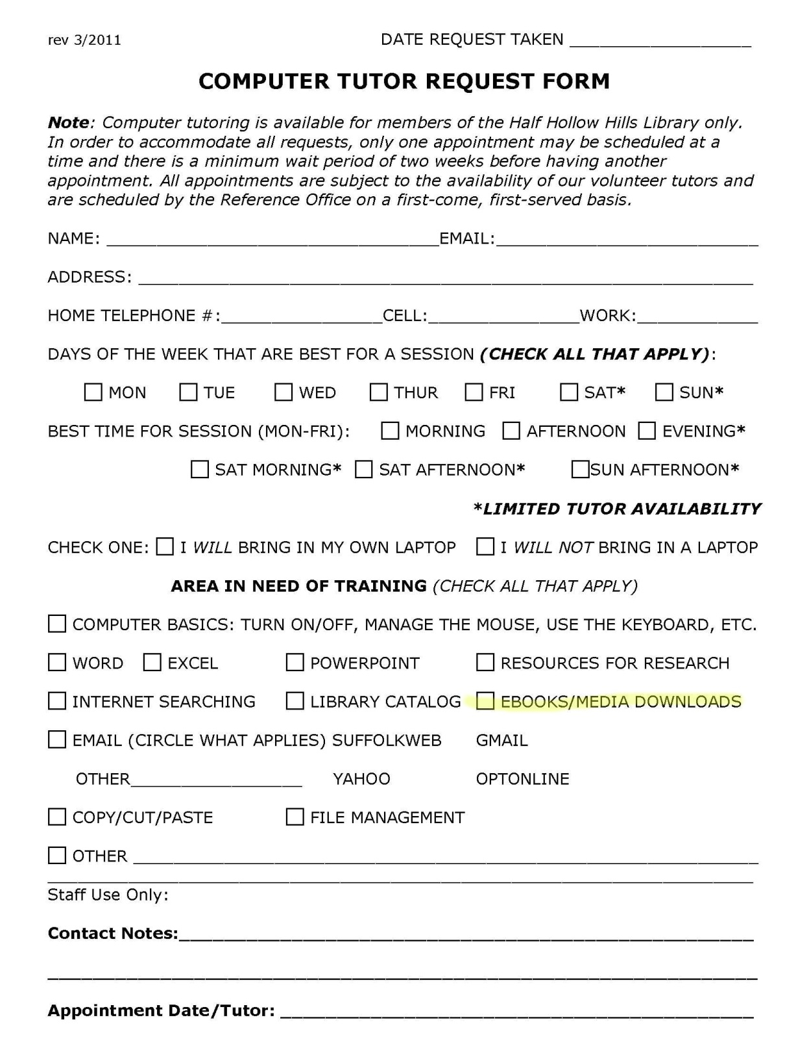
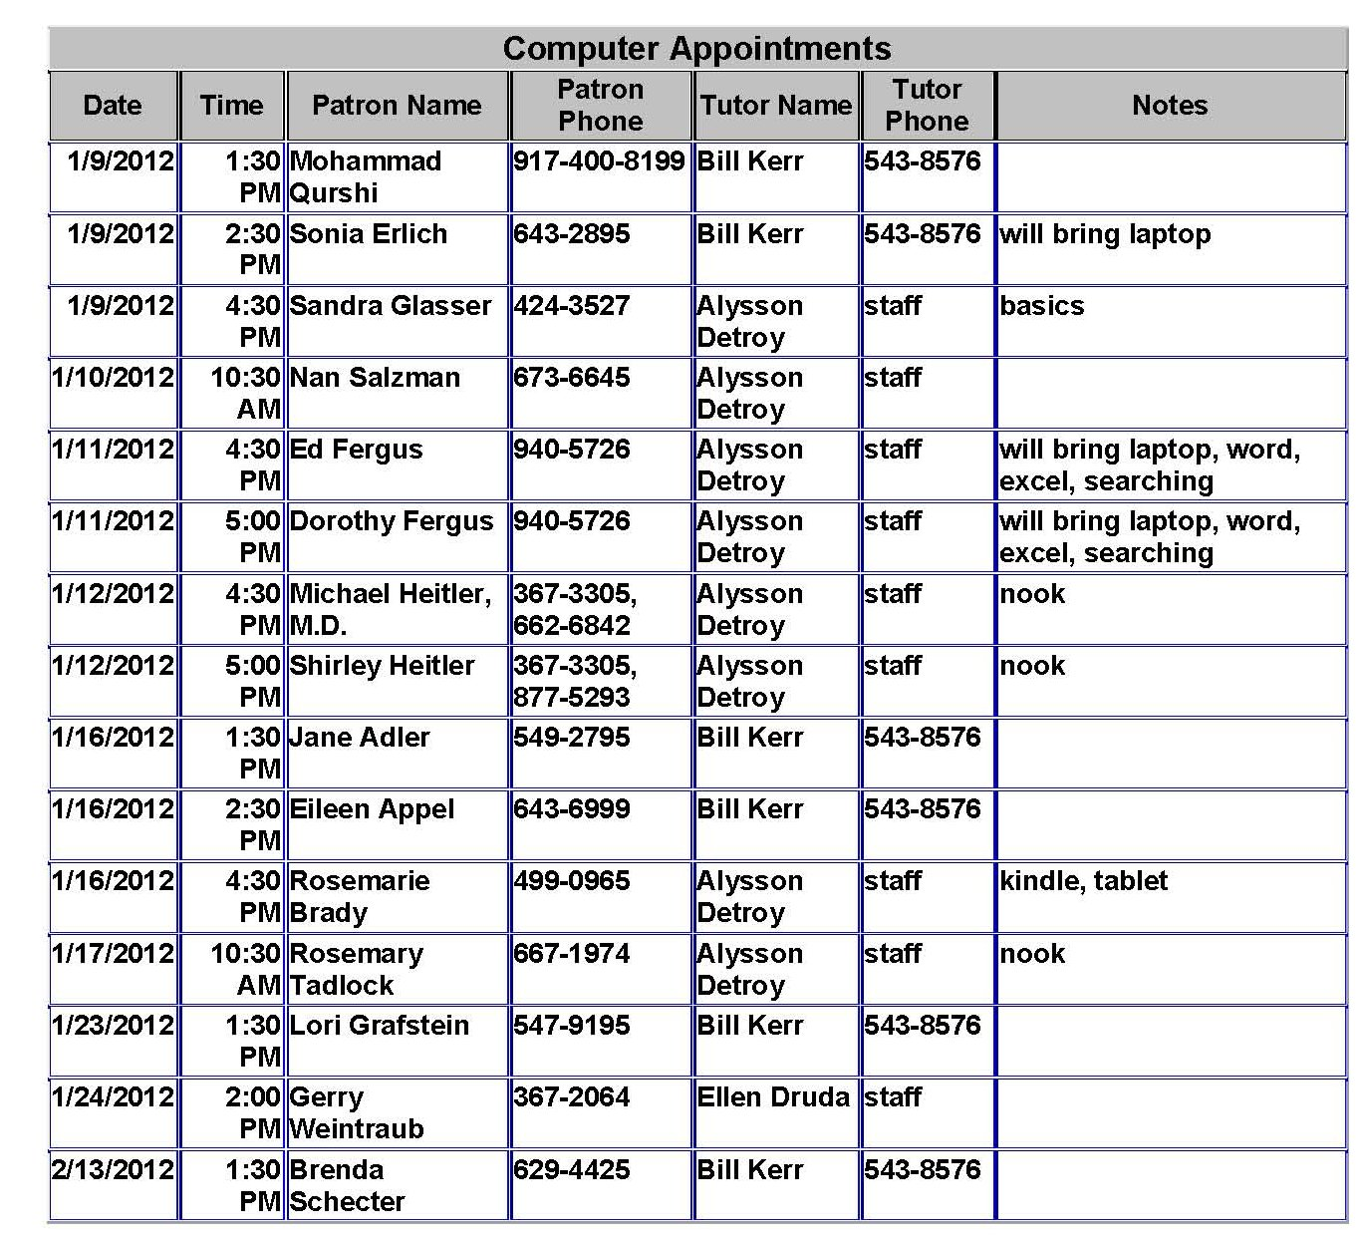
Patron training: appointments

Slide 9
Staff training: Problems
Uneven staff skills
Desk coverage
Do we really need to know?
Buy-in from administration

Slide 10
What doesn’t work
Voluntary
Scheduled for trainer’s convenience

Slide 11
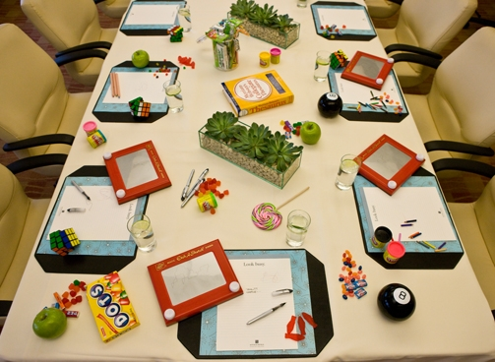
What works
Small groups
Hands-on if possible
Low key
Reassure staff they don’t need to know it all
Re-train if needed
Peer-to-peer sharing

Slide 12
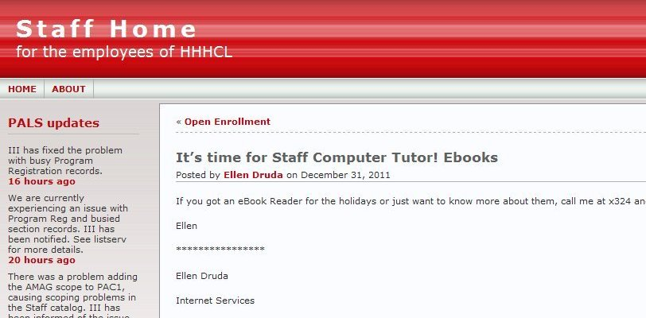
Right now
Training departments
Training staff members
Patron user groups
Patron one-to-one by appointment
Patron drop-in

Slide 13
Thank you!

