Slide 1
Digital Collections
SCLA RASD Media Committee
October 16, 2017

Slide 2
New York State Historic Newspapers
http://nyshistoricnewspapers.org/

Slide 3
How to Participate
Send microfilm or physical papers to SCLS
Papers can be scanned directly to digital files and uploaded
Digital files can create new film
Microfilm is scanned and sent offshore for processing
Hosted by NNYLN
No customization

Slide 4
New York Heritage
https://www.nyheritage.org/

Slide 5
How to Participate
Join LILRC
Complete Content DM Training
Hosted at OCLC
No customization

Slide 6
LOC Veterans History Project
https://www.loc.gov/vets/

Slide 7
How to Participate
Anyone – instructions on their site
Hosted by LOC
No customization

Slide 8
SCLS Digital Collections - TBD
Exploring several platforms
Odilo – pay for hosting –customizable
ResCarta – SCLS possibility – some customization… TBD

Slide 9
StoryCorps Oral History Project
Borrow Recording Equipment from SCLS Lending Library
Workshops coming in the near future to learn the how-to.
Hosting options depending on the previous sites….

Slide 10
Getting Your Collections Discovered
Link to the hosting platform from your website
Use specific URLs if possible
Create a custom webpage to display and link to the hosted files
Embed the links in images
Cataloging a MARC record
Use a general record to represent the site
Catalog every item individually

Slide 11
Cataloging Needed
Content DM requires Dublin Core and you fill in a form
(That’s what you learn in the LILRC training)
Other platforms may not follow Dublin Core, but may have tagging and simple indexes

Slide 12
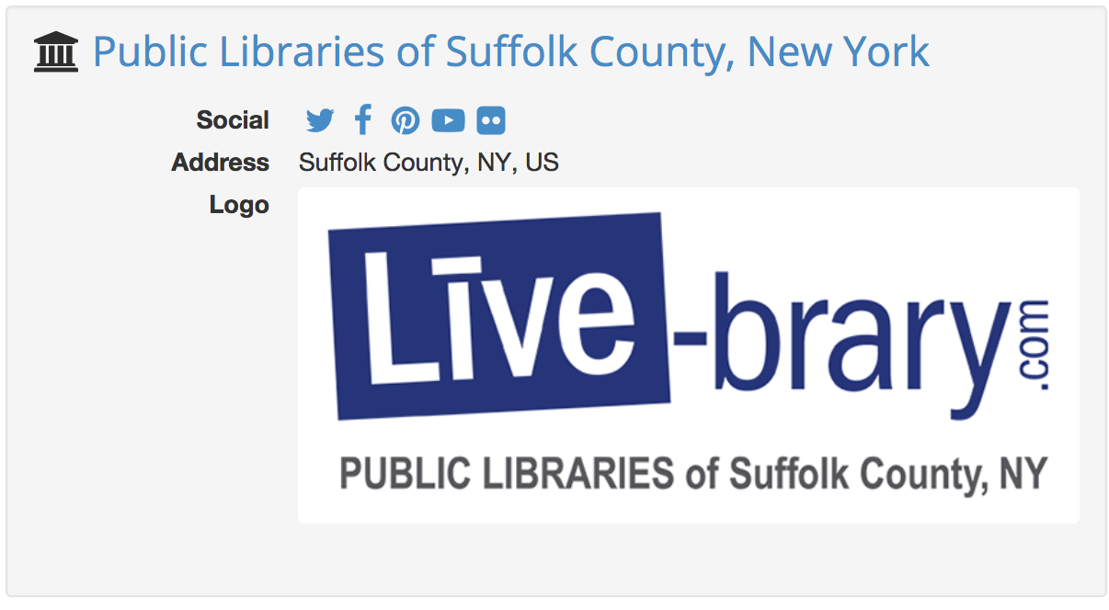
LINKED DATA
Link.livebrary.com

Slide 13
County Catalog Loaded Monthly
Print, Serial, Media, OverDrive
Novelist Appeal Terms linked
NYTimes Bestsellers linked
*Next Big Thing* linked

Slide 14
Embed Living Lists by subject

Slide 15
Living Lists
Update Automatically with new purchases or deletions
Select grid, one title, or list views
Create lists based on any fields or Novelist Appeal Terms
All lists click back to Encore to place holds
All lists show locations held

Slide 16
Share on Social Media

Slide 17
AI Coming Soon….
“Alexa… go to Link.Livebrary and download ‘The Whistler’ audiobook and play it for me.....”

Slide 18
Want to Learn More?
Video from SCLS Linked Data Meeting
Ideas.Ted.Com Tim Berners-Lee’s campaign for open data
The Next Web – Tim Berners-Lee’s Ted Talk 2009

Slide 19
Sample Collections
East Hampton Library
John Jermain Memorial Library
Mastics Moriches Shirley Community Library
Sachem Public Library

