Slide 1
Chronic Kidney Disease
Sandeep K. Mallipattu
Stony Brook Medicine
Medicine/Nephrology
November 6, 2018

Slide 2
Disclosures
None

Slide 3
Kidney Function
Filter 200 Liters of blood
Removal of Waste
Balance fluids and minerals
Regulate Blood Pressure
Bone health
Hormone balance
Make Red Blood Cells

Slide 4
Kidney Damage can lead to:
Heart Disease
High Blood Pressure
Bone Disease
Anemia
Nerve damage
Weakness
Reduced urine output

Slide 5
Early Kidney Damage
Underdiagnosed
Silent Disease till late stages

Slide 6
National Kidney Foundation

Slide 7
Main Causes of CKD worldwide
Diabetes
Hypertension

Slide 8
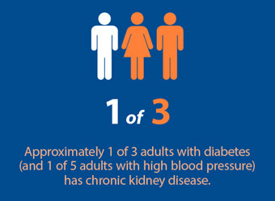
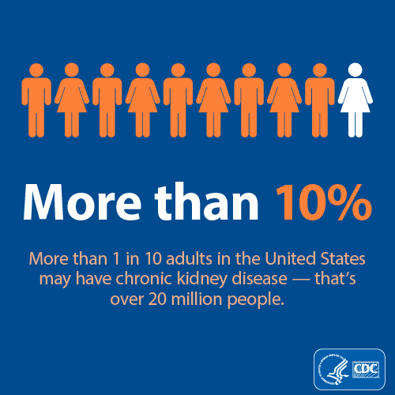

Slide 9
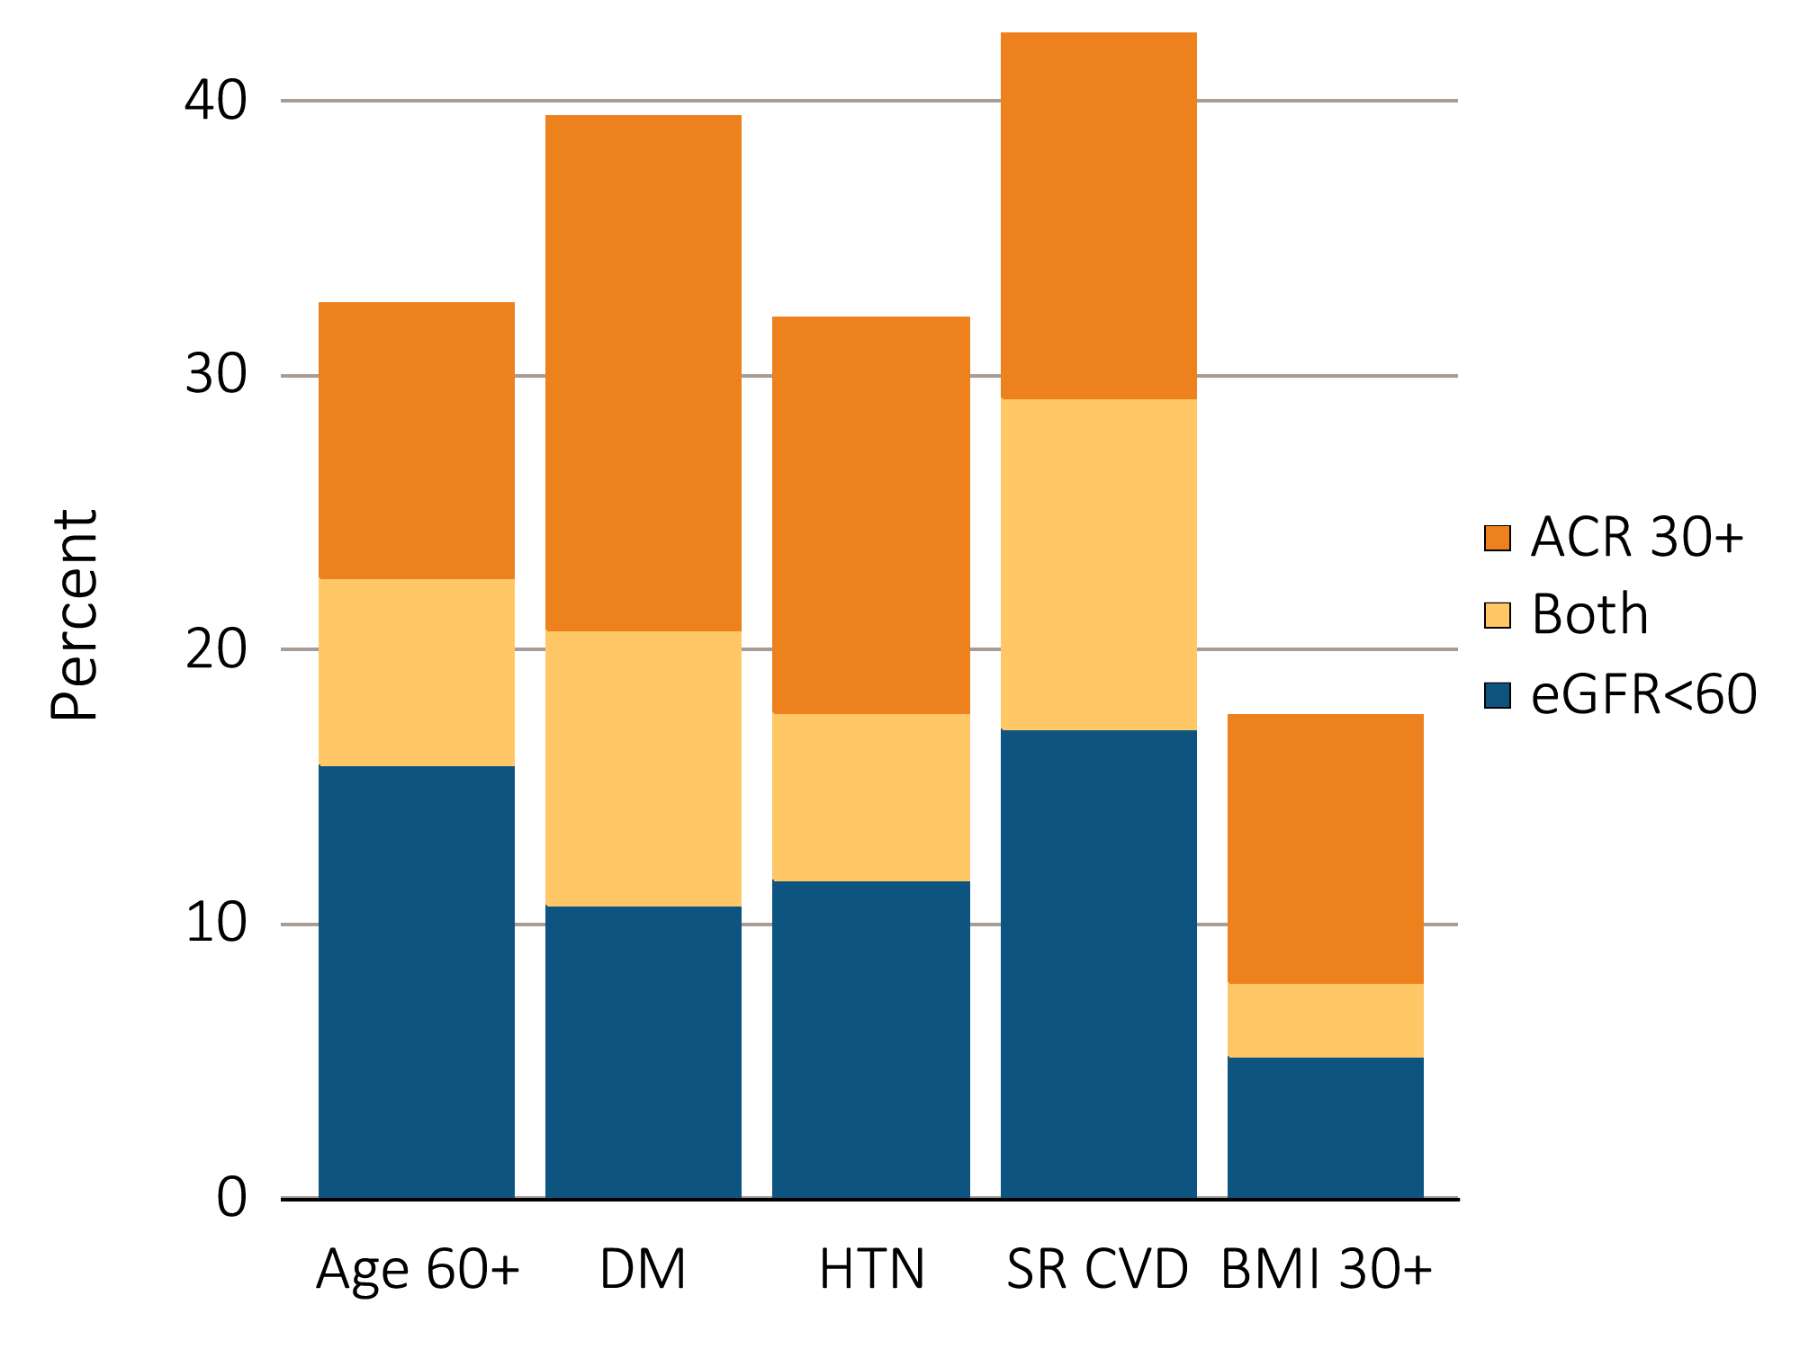
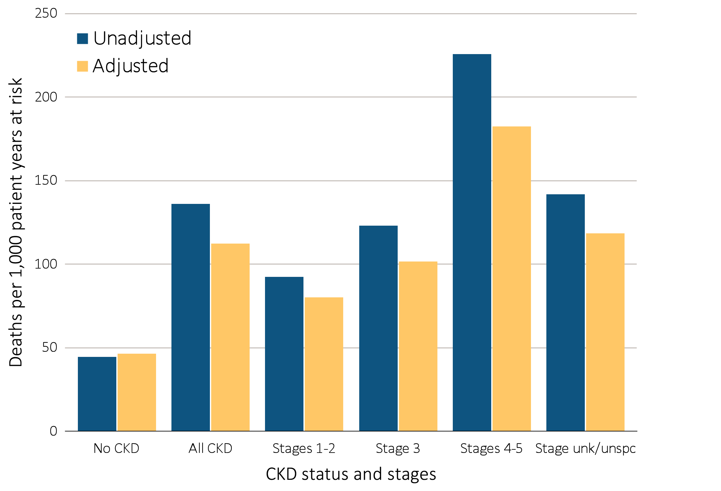
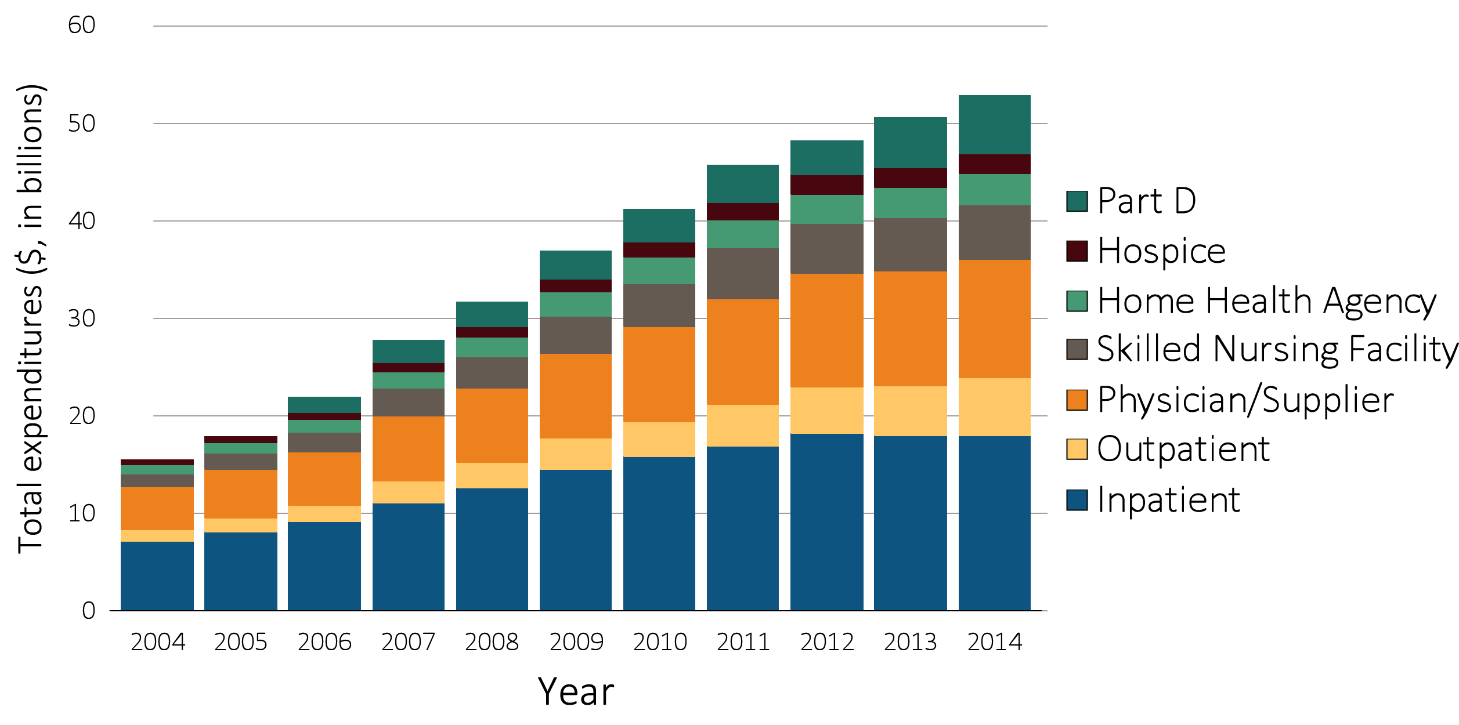
Chronic Kidney Disease
~ 20% yearly mortality on dialysis
6.2% of Medicare budget ($34 billion)
No sustainable therapies to prevent/reverse kidney disease
USRDS 2016
Notes:
Besides kidney transplantation and taking care of your DM and BP

Slide 11
Need for CKD and ESRD care
CKD prevalence (United States) ~ 15% (30 million Americans)
Medicare ~ $98 billion on CKD (20%)
$34 billion for ESRD on dialysis
ESRD burden in NY state (CMS):
Prevalence ~ 44,000
Incidence ~ 7500 per year
Admission rate ~ 1459 per 1000 patient years
ESRD burden in Suffolk County (CMS):
Prevalence ~ 6.8%
Incidence ~ 550 - 575 per year
Admission rate ~ 1603 per 1000 patient years
CDC
USRDS (2015) data

Slide 12
CDC
USRDS (2015) data

Slide 13
Am I at risk?
Age > 60 years
Family History of CKD
History of Diabetes and/or High Blood Pressure
Genetic:
African Americans
Hispanic Americans

Slide 14
How do I check if I’m at risk
Annual Urine analysis
Measures protein
Annual Blood Test for Creatinine:
Measures GFR

Slide 15
How to prevent Kidney Disease?
Annual urine and blood test
Remind your primary care doctor
Eat healthy
Reduce excess carbs and protein
Reduce excess salt
Avoid certain pain medications
Non-steroidal anti-inflammatory agents (NSAIDS)

Slide 16
Kidney Stones Risk Factors
Family History of Kidney Stones
Dehydration (occupations with limited access to water)
Diet (excess red meats, shellfish)
Most stones are not from excess calcium!!!

Slide 17
Come see us for an evaluation!
Appointment: 631-444-0580

